Slide 1
Multimedia Class 2016 TA Class
Slide 1:
Introduction to Image Processing using MATLAB

Slide 2
First things first
Edmodo is for handing out your homework and announcements
Group Code: a6s3az
Each homework usually has about 7-10 days
I will be in SPRL lab on Mondays, in case you have any questions (3rd Floor)
** PLAGIARISM IS “NOT” TOLERATED! (you’re better off not turning in your homework)**
About half of your score is the homework that you turn in
The rest will be your final course project
Do something cool, you will enjoy it ;-)
Start thinking about it
Try new fields in computer vision / image processing / audio processing / …
It takes more than a couple of days to learn using MATLAB!!!

Slide 3
Outline
Introduction to MATLAB
Basics and examples
Introduction to Image Representation in MATLAB
Basics and examples

Slide 4
Why MATLAB?
MATLAB = Matrix Laboratory
MATLAB is a high-level language and interactive environment that enables you to perform computationally intensive tasks faster than with traditional programming languages such as C, C++ and Fortran.
MATLAB is an interactive, interpreted language that is designed for fast numerical matrix calculations
A huge amount of Toolboxes and Code samples (Check out your MATLAB Help)
A de facto standard framework for academic advancements
Except for its competitor in computer vision: OpenCV

Slide 5
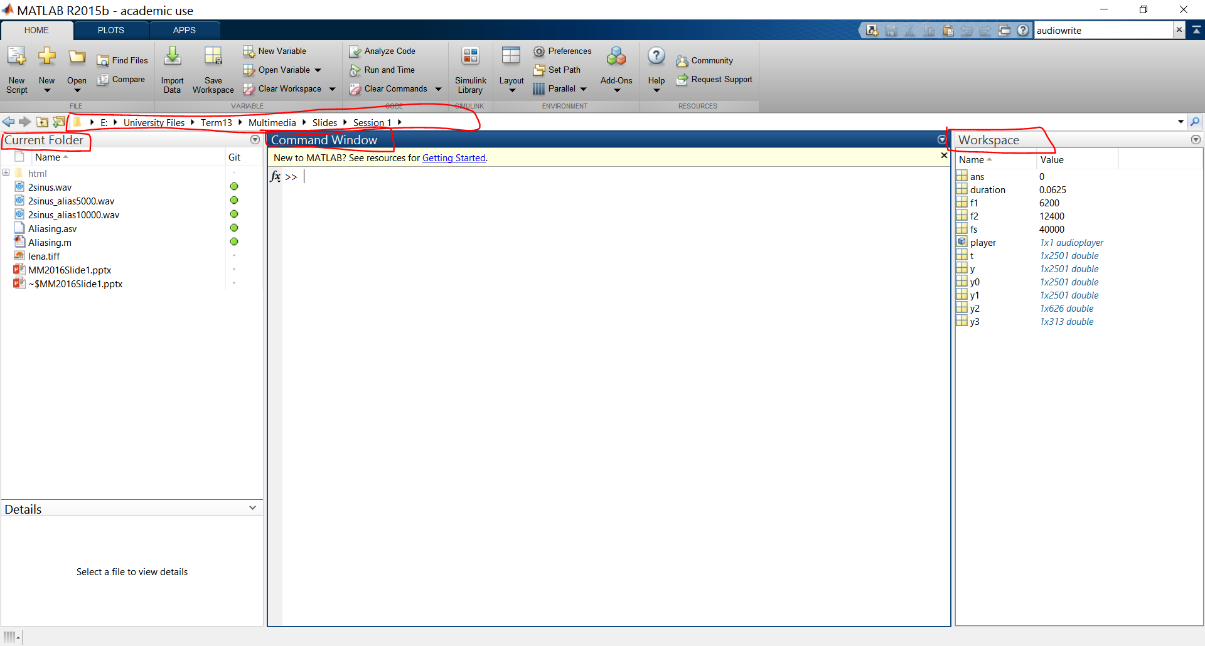

Slide 6
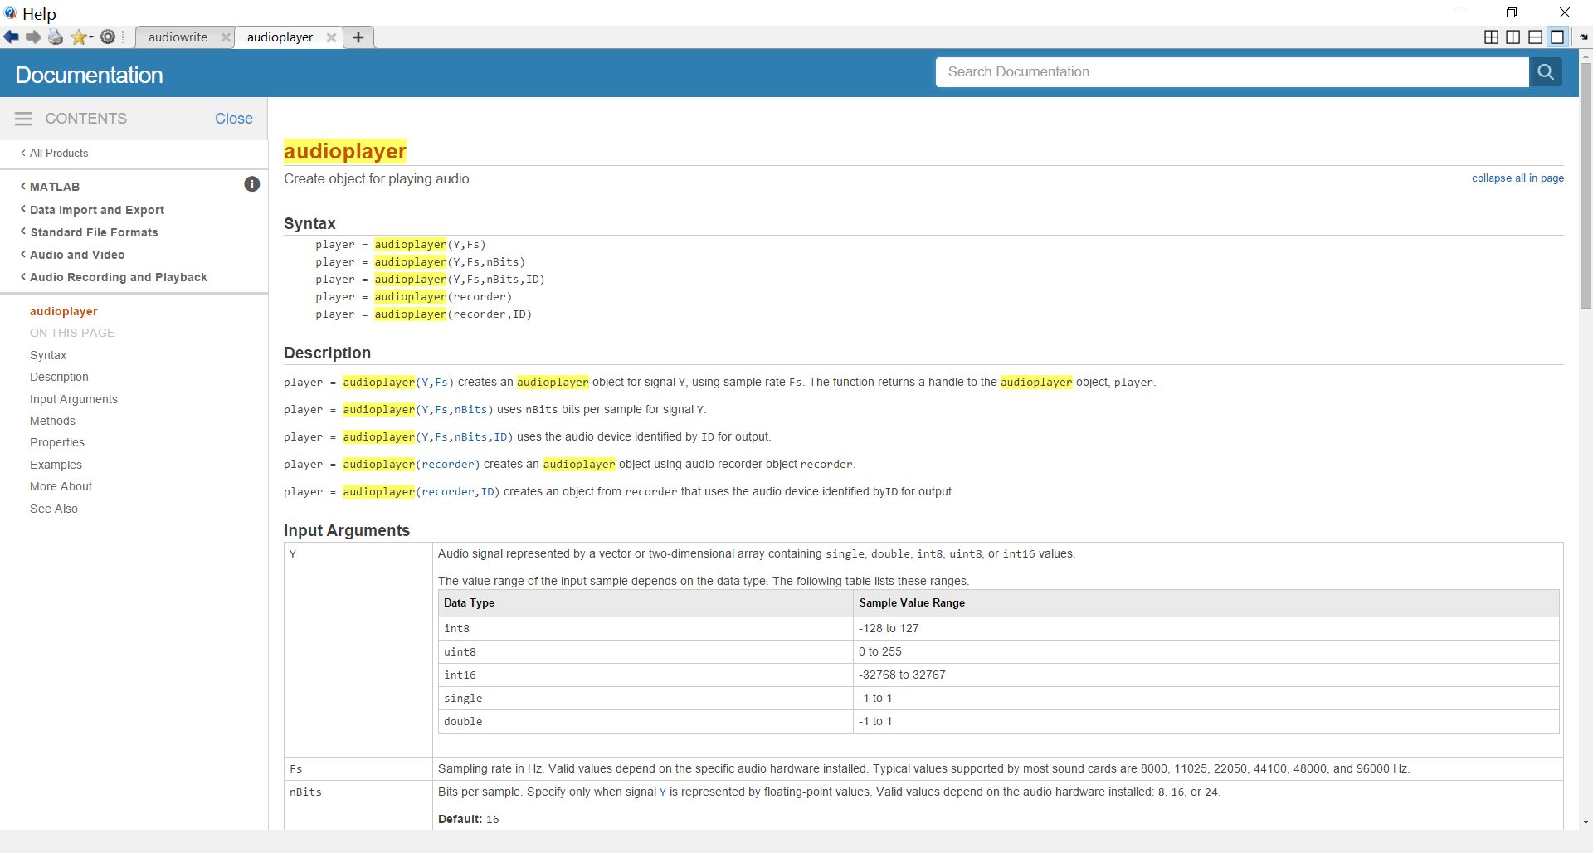

Slide 7
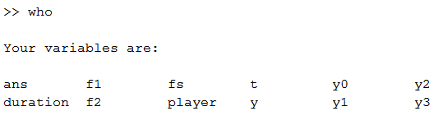
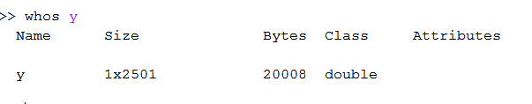
MATLAB Basics
To find out the type and value of a variable you are using: who, whos
Saving and loading variables to *.mat files: save, load
A good practice to include in your files before doing anything:
clear all, clc, close all, fclose all;

Slide 8
MATLAB Basics
Main matlab variable type: Matrix
Creating matrices:
A = [1 2 3; 4 5 6; 7 8 9]
Special Matrices: zeros, ones, rand, randn, eye
Finding size of matrix: size(A) = [3 3]
Sum(A), sum(A, 2), sum(sum(A))
CODE
Finding something in a matix:
Find(A < 4)

Slide 9
Control statements
If statement
Switch statement
For loop
While loop
Continue
Break
End
Whenever in doubt, use MATLAB Help

Slide 10
M-Files
There are 2 kinds of *.m files
Functions
Well, you should know what functions are, if not, Google it ☺
We will get into more details later
Scripts
Scripts are simple MATLAB code that will be run line by line
It’s like you would run them line by line in command window

Slide 11
Any Questions?
BTW, we have GIT!
Check my website for downloading MATLAB and getting the GIT link
www.nmahmoudi.ir/teaching.php

Slide 12
Let’s get to business
Check the MATLAB Code

